Slide 1
Computer Graphics
Illumination Models & Surface Rendering Methods

Slide 2

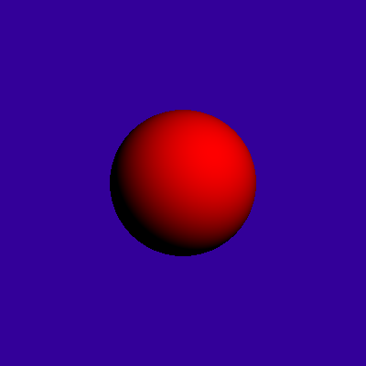
Why Lighting?
If we don’t have lighting effects nothing looks three dimensional!

Slide 3
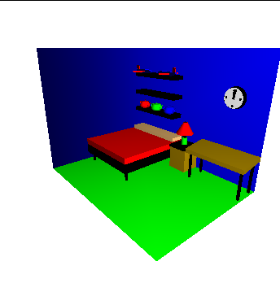
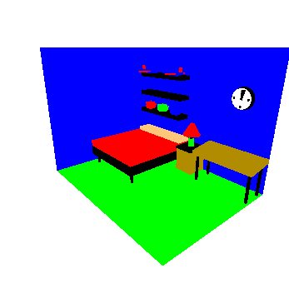
Why Lighting? (cont…)

Slide 4
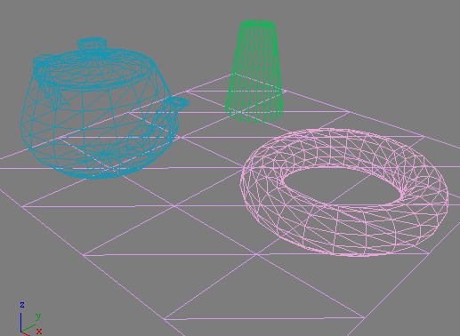
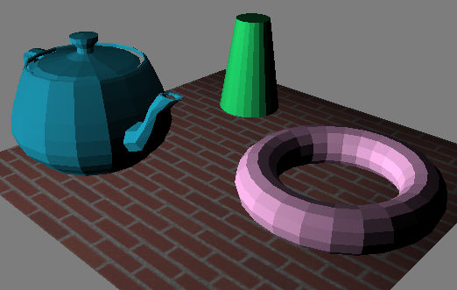
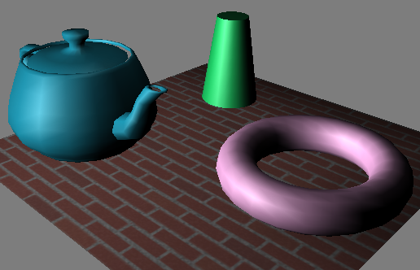
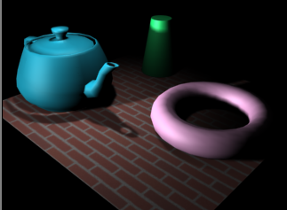
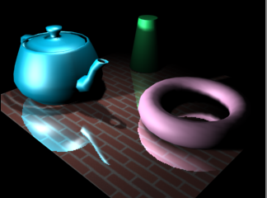
Introduction
Realistic displays of a scene
  Perspective projections of objects
  Applying lighting effects

Slide 5
Introduction (Contd.)
Illumination model
  Lighting model or Shading model
  Calculate the intensity of light for a given point on the surface of an object
Surface-Rendering algorithm
  Use the intensity of a given point to determine the light intensity for all projected pixel position in a polygon

Slide 6


Light Sources
Types of light source
  light source (direct)
  light reflector (indirect)
Two light emitter models
  Point light source, see (b)
  Distributed (Area) light source, see (a)
(a)
(b)

Slide 7
Illumination Models
Concerning methods for calculating light intensity
  Also called Lighting Models
  An approximation for physical optical laws
- Position
- Orientation
- Material
- Light source
- Viewer
N
L
V

Slide 8
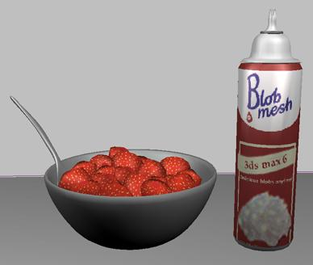
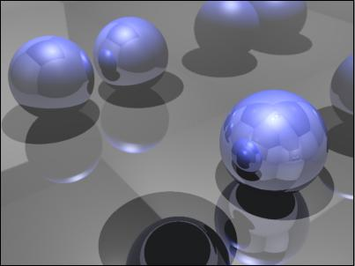

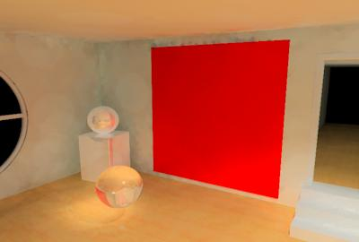

Types of illumination models
Local Illumination Models
  Only considering the interchanges of the light sources
Global Illumination Models
  Concerning the interchange of light between all surfaces
  Ray-Tracing, Light as a particle
  Radiosity, Light as a energy

Slide 9

Reflected Light
The colours that we perceive are determined by the nature of the light reflected from an object
For example, if white
light is shone onto a
green object most
wavelengths are
absorbed, while green
light is reflected from
the object
White Light
Colours Absorbed
Green Light

Slide 10
Background
Illumination model (Shading Model) is used to Calculate intensity of light that we see at a given point on the surface of an object
Surface Rendering algorithm uses the intensity calculation from an illumination model to determine the light intensity of all pixel positions for various surfaces in the scene
Photorealism in computer graphics involves two elements:
  Accurate graphical representations of object
  Good physical descriptions of lighting effect in scene
Illumination model: derived from physical laws that describe surface light intensities

Slide 11
Basic Illumination Model
Ambient Light → Background Light
  Object not exposed directly to a light source is visible with ambient light
  Has no spatial or directional characteristics
  Amount of ambient light incident on each object is a constant for all surfaces and over all directions
  Level for the ambient light in scene by parameter I_{a}
  Each surface in the scene is illuminated with the constant intensity level I_{a}
  The intensity of reflected light (intensity of illumination) depends upon optical properties of the surface
  Ambient light produces flat shading → not desirable in general, so scenes are illuminated with other light source together with ambient light

Slide 12
Basic Illumination Model
Diffuse Reflection
  Reflected light intensity are constant over each surface in a scene independent of viewing direction → ideal diffuse reflectors
  the diffuse-reflection coefficient (diffuse reflectivity) → k_{d}
    Sets the fraction of light intensity that is reflected from each surface
    k_{d} is a the function of surface color, but for our purpose we assume k_{d} to be constant
  Diffuse reflection intensity when scene illuminated only with ambient light:
  I_{ambdiff} = k_{d}I_{a}
  Lambertian reflectors
    Follow lambart’s cosine law → radiant energy from a small surface area dA is proportional to the cosine of angle θ between surface normal and incident light direction
      For a point source with intensity I_{l}, the diffuse reflection intensity is
      I_{l,diff} = k_{d}I_{l}cosθ
      I_{l,diff} = k_{d}I_{l}(N.L)
      Where N and L are unit vectors
N
L
θ

Slide 13
Diffuse Reflection
Dull and matte surfaces exhibit diffuse reflection
  Equally bright from all viewing angles
The intensity on a given surface depends on the angle θ between the light's direction L and surface's normal N
I= I_{a}K_{a}+ I_{p}K_{d}cosθ
  I_{p} : Intensity of point light source
  K_{d} : diffuse-reflection coefficient (0 ~ 1)
  cosθ : max( cos θ, 0)
N
L
V

Slide 14
Total Diffuse Reflection
Assuming that N and L have been normalized,
I= I_{a}K_{a}+ I_{p}K_{d}(N dot L)
  L is a constant if a point light source is at infinite
  (Called directional light source)

Slide 15
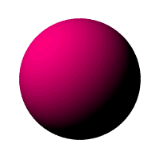




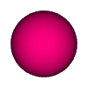
Basic Illumination Model
Diffuse reflection for ambient light source + a point light source
  I_{diff} = k_{a}I_{a} + k_{d}I_{l}(N.L)
Fig:
  sphere illuminated with different intensity ambient light
  Illuminated with varying direction light source

Slide 16
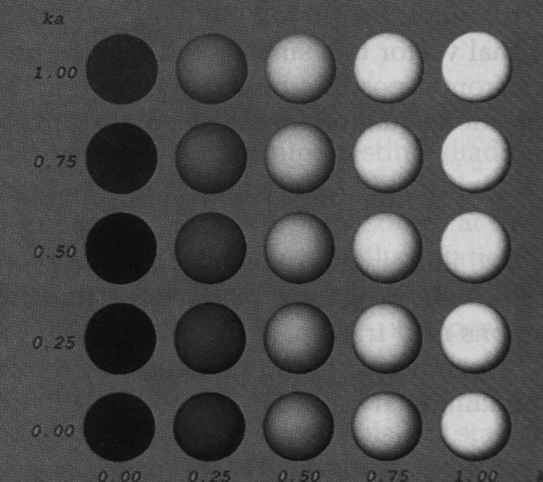
Visual effects of different values of K_{d} and K_{a}

Slide 17
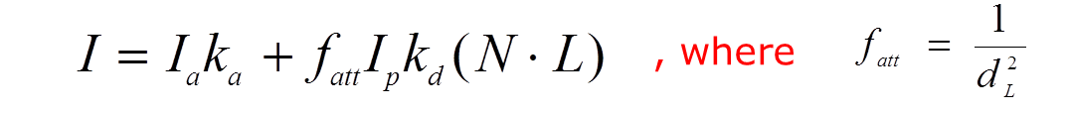
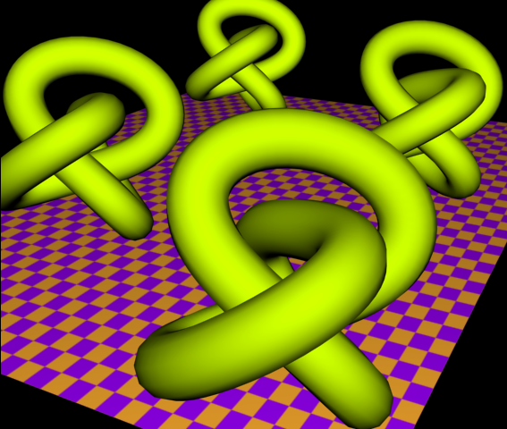
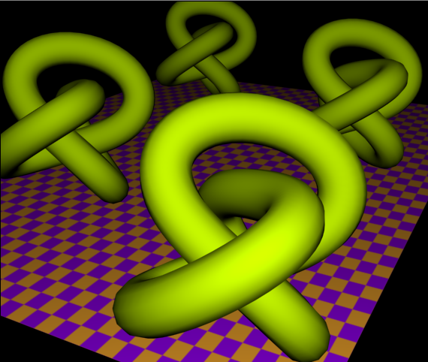
Diffuse Reflection - Further Discussions
Light-source attenuation
Colored lights and surfaces
  Similar for I_{G} and I_{B}.

Slide 18

Specular Reflection
Bright spot seen at an illuminated shiny surface when viewed at certain direction
  Polished metal surface, person’s forehead, apple etc. exhibit specular reflection
In fact an image of light source
Result of total or near total reflection of incident light in a concentrated region around the specular reflection angle θ
Fig:
  L → unit vector pointing to light source
  N → unit surface normal vector
  R → unit vector in direction of specular reflection
  V → unit vector pointing viewer
Ideal reflector exhibit specelur reflection in the direction of R only (i.e Ø=0) but for non-ideal case specular reflection is seen over finite range of viewing positions
N
L
R
θ
θ
Ø
V

Slide 19
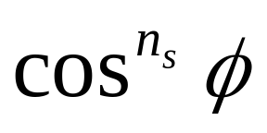

Phong Model
Intensity of specular reflection: proportional to
    n_{s} → specular reflection parameter (depends on surface)
    Ø ranges from 0 to 90⁰ (i.e cos Ø varies from 0 to 1)
Intensity of specular reflection depends on:
  Material properties of surface
  Angle of incidence θ
  Other factors such as polarization and color of the incident light
Monochromatic specular intensity variations can be approximated using specular-reflection coefficient, w(θ) for each surface
At θ = 90⁰, w(θ) = 1 → all incident light is reflected
N
L
R
θ
θ
Ø
V
N
L
R
N
L
R

Slide 20
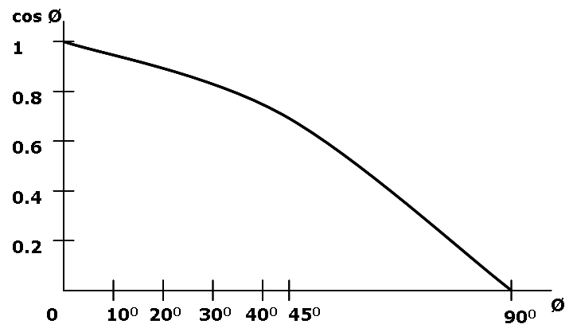
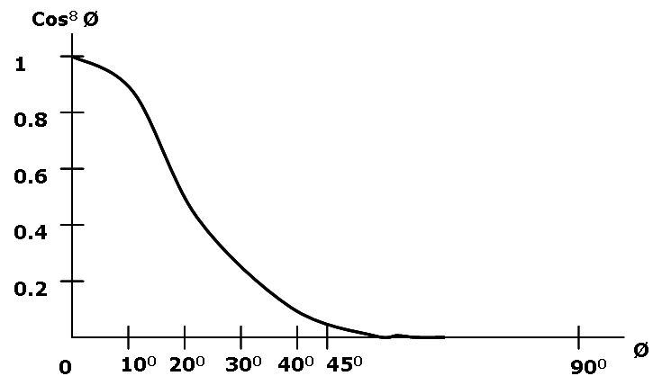
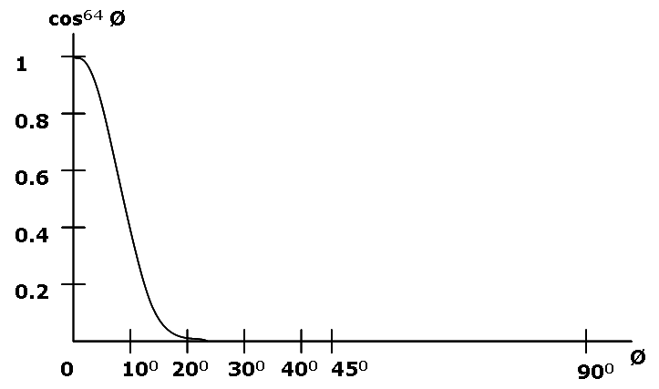
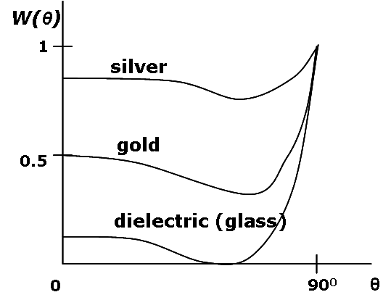
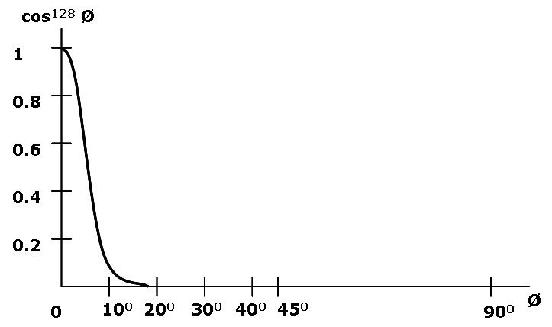
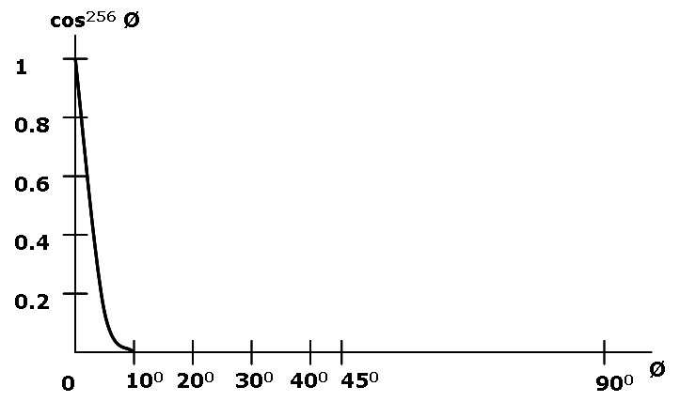
Plot For and Specular Reflection Coefficient For Various Materials

Slide 21



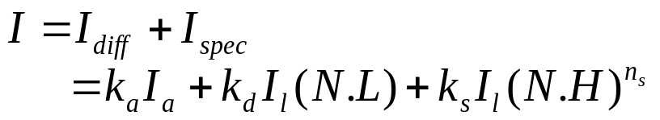
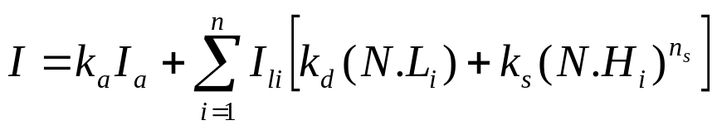
Phong Model (contd…)
Simplified form: assume w(θ) = k_{s} = constant
Vector R can be evaluated from vectors L an N as:
    R + L = (2N.L)N
    i.e R = (2N.L)N – L
Further simplified by replacing V.R with N.H where H is halfway vector between L and V (i.e H is unit bisector vector of angle between L and V)
Thus
If we add ambient light and diffuse reflection component then total intensity is given as:
For multiple light sources (n light sources)
L
L
N
R
N.L
L
N
H
R
α
Ø
V
When v is coplanar with L and R
α = Ø/2 otherwise α > Ø/2

Slide 22
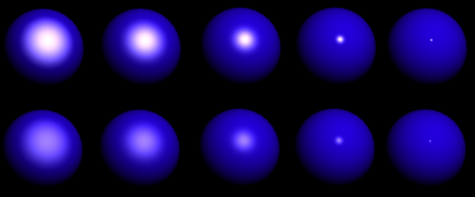
Visual Effects of Specular Reflections
K_{s}
1.0
0.5
8
16
32
64
128
Shinness

Slide 23
Polygon Rendering Methods
Illumination model is applied to fill the interior of polygons
Curved surfaces are approximated with polygon meshes
  But polyhedra that are not curved surfaces are also modeled with polygon meshes
Two ways of polygon surface rendering
  Single intensity for all points in a polygon
  Interpolation of intensities for each point in a polygon
Methods:
  Constant Intensity Shading
  Gouraud Shading
  Phong Shading

Slide 24

Constant Intensity Shading
Flat shading
  Each polygon shaded with single intensity calculated for the polygon
Useful for displaying general appearance of a curved surface
Accurate rendering conditions:
  Object is a polyhedron and not an curved surface approximation
  All light sources should be sufficiently far from the surface (i.e N.L and attenuation function are constant over the polygon surfaces) :constant diffuse reflection??
  Viewing position is sufficiently far (i.e V.R is constant over the surface) : Specular Reflection ??
  Note: Approximate rendering is possible even the conditions are not satisfied
Drawback: intensity discontinuity at the edges of polygons
Credit goes to the students

Slide 25
Gouraud Shading
Calculation Steps:
  Determine the average unit normal vector at each polygon vertex
  Calculate each of the vertex intensities by applying an illumination model
  Linearly interpolate the vertex intensities over the polygon surface
Intensity discontinuity at the edges of polygons is eliminated
Drawback:
  Mach bands: bright and dark intensity streaks caused by linear interpolation of intensities
    Could be reduced by dividing the surface into large number of polygons or by using other methods, such as Phong shading

Slide 26
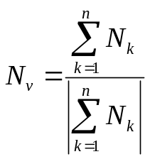
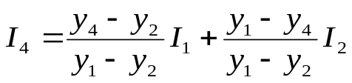
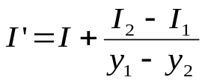
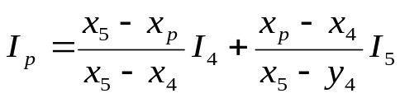
Gouraud Shading (contd…)
N₂
N₃
N₁
Average Unit Normal: Obtained by averaging the surface normals of all polygons sharing the vertex
Intensity interpolation:
  Along the polygon edges are obtained by interpolating intensities at the edge ends
  Along the scan line between the polygon edges are obtained by interpolating intensities at the intersection of scan line and polygon edges
N₄
V
y
3
1
P
scan line
4
5
2
Recursive calculation along the edge
x
I₁
y
I
scan lines
Recursive Calculation
along the scan line ??
y-1
I’
I₂
x
x+1

Slide 27
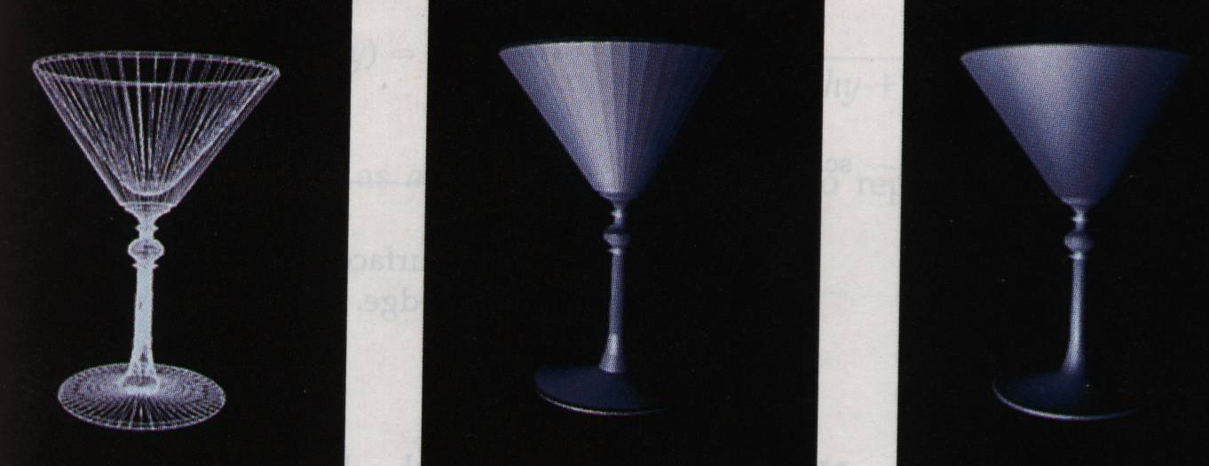

Slide 28

Phong Shading
More accurate method for rendering
Fundamental: Interpolate normal vectors and apply illumination model to each surface point
Calculation steps:
  Determine average unit normal vectors at each polygon vertex
  Linearly interpolate the vertex normals over the surface of the polygon
  Apply an illumination model along each scan line to calculate projected pixel intensities for the surface points
Trade-off: requires considerably more calculations
N₁
(x₃,y₃)
N₃
y
(x₁,y₁)
N
Scan line
(x₂,y₂)
N₂
x
Note: Students are encouraged to read
Fast Phong Shading which could be useful
for project works

Slide 29
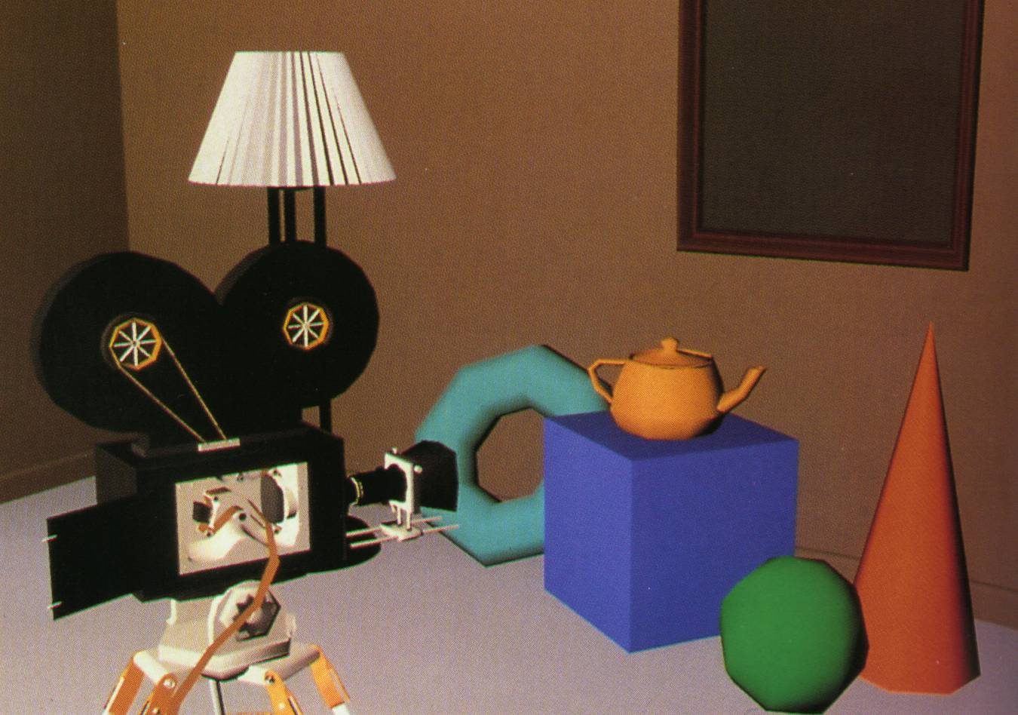
Gouraud Shaded Polygons with Diffuse Reflection

Slide 30
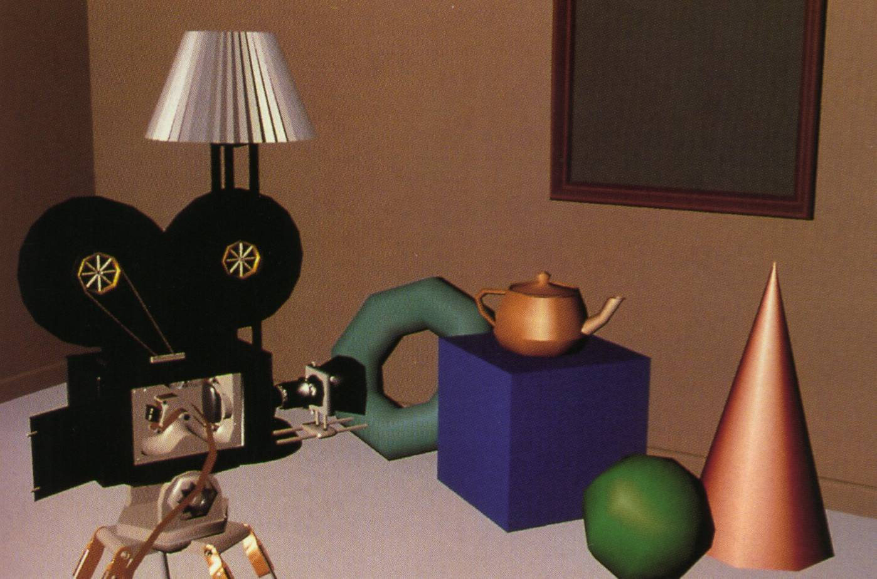
Gouraud Shaded Polygons with Diffuse and Specular Reflection

Slide 31
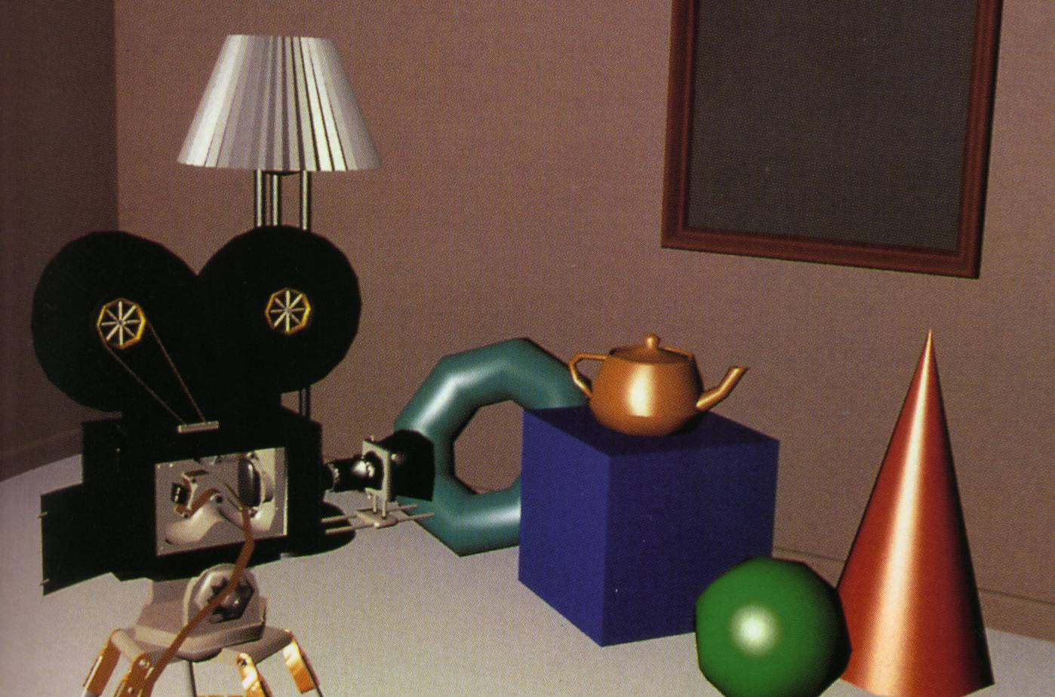
Phong Shaded Polygons with specular Reflection

Slide 32
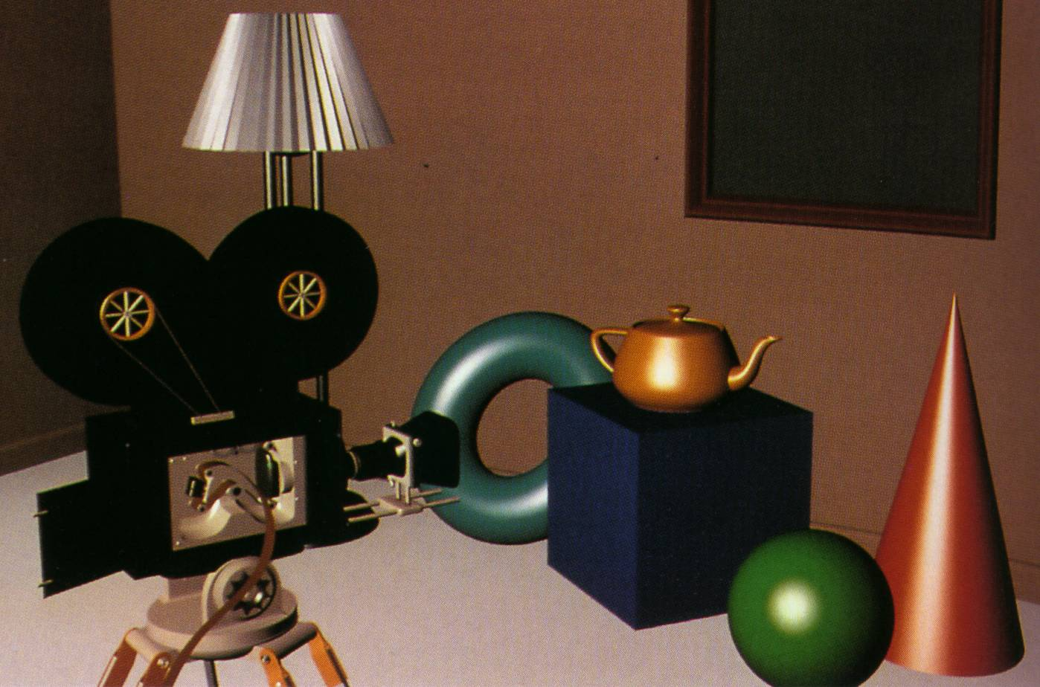
Curved Surfaces with Specular Reflection

Slide 33
The Rendering Pipeline
For Z-buffer and Phong shading
Modeling
transformation
Viewing
transformation
Modeling
Rasterization
(including shading)
Clipping
Display

